Slide 1


I Project Presentation (KCS 753) Hi! Drive
KIET Group of Institutions, Ghaziabad
(An ISO – 9001: 2008 Certified & ‘A+’ Grade accredited Institution by NAAC)
Guide : Mr. Amit Sanger
Project Members
1. Akshat Singh 2000290120018 (CS 7A)
2. Aman Verma 2000290120021 (CS 7A)
3. Anmol Patel 2000290120027 (CS 7A)

Slide 2
Problem Statement
As we have seen in the current existing system that people face difficulty in hiring driver for their own cars so they try to rent a car to travel. So, to overcome this problem we are developing our App “Hi! Drive" in which we will providing drivers on rental to customer who have their own car but are not able to drive. In which they can easily search drivers on job nearby them and hire them on duty.

Slide 3
Objectives
Maintain driver’s database.
Make driver list available to user from the nearest area.
Tracking driver’s location using GPS and off-track alert system.
Self-registration for drivers and users.

Slide 4
Technology Used
Front-end:
React JS
Next JS
HTML , CSS, JavaScript
Backend:
REST framework
Node JS
Express JS

Slide 5
Literature Survey
Sandeep Gupta, Attaullah Buriro, Bruno Crispo
“DriverAuth: Behavioral biometric-based driver authentication mechanism for on-demand ride and
ridesharing infrastructure.”
A behavioural-biometric-based authentication [1]
scheme in the context of on-demand ride and the rideshare
services. The approach can be extremely useful to verify
drivers remotely.
Kacem Abida, Rainer Stahlmann, Florian Netter, and Carlo
Ratti “Driving Behavior Analysis through CAN Bus Data
in an Uncontrolled Environment.”
Driving behavior analysis has been studied from a new
point of view, that bridges the gap between driving behavior
studies through uncontrolled experiments leveraging only
the GPS signal and studies exploiting CAN bus data through
very controlled experiments.

Slide 6
Dr. Ruchi Shukla, Dr. Ashish Chandra & Ms. Himanshi Jain
“OLA VS UBER: The Battle of Dominance.”
India’s major attractiveness lies in its market size and
increased purchasing power resulting in uplifting lifestyles.
On the other hand, Indian consumers are smart, very
demanding and highly price-sensitive with no brand loyalty
Dr. P. Kishore Kumar1, Dr. N. Ramesh Kumar2
“A Study on Factors Influencing the Consumers in Selection of Cab Services.”
The customer satisfaction about the call taxi services,
the factors they give importance in selection of the service
provider, tariff, comfort, convenience, service quality and
customer care rendered [5]. The finding depicts the exact
replica of the customer’s mindset and level of satisfaction
towards the service providers operating the call taxi in the
Chennai market.

Slide 7
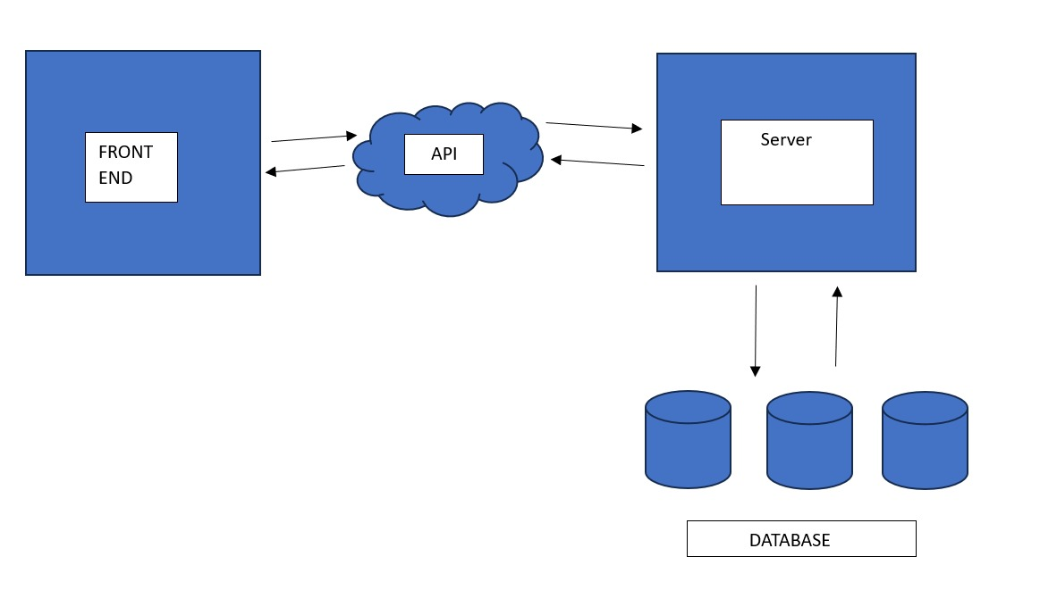
Workflow Diagram
Diagram to show the process involved in the project.

Slide 8
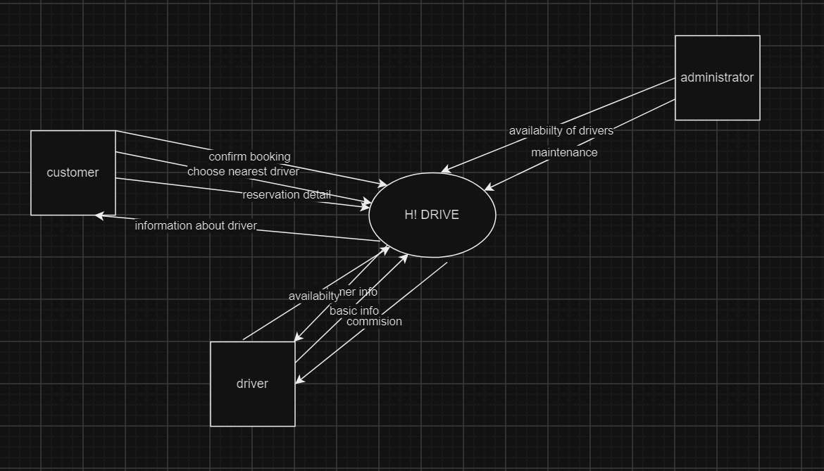

Slide 9
Patent Status
Completed and sent to mentor.

Slide 10
Research Paper Status
Completed 60%
abstract, introduction, motivation, system analysis, proposed system.
PENDING 40%
existing system, future scope, acknowledgement, algorithms.

Slide 11
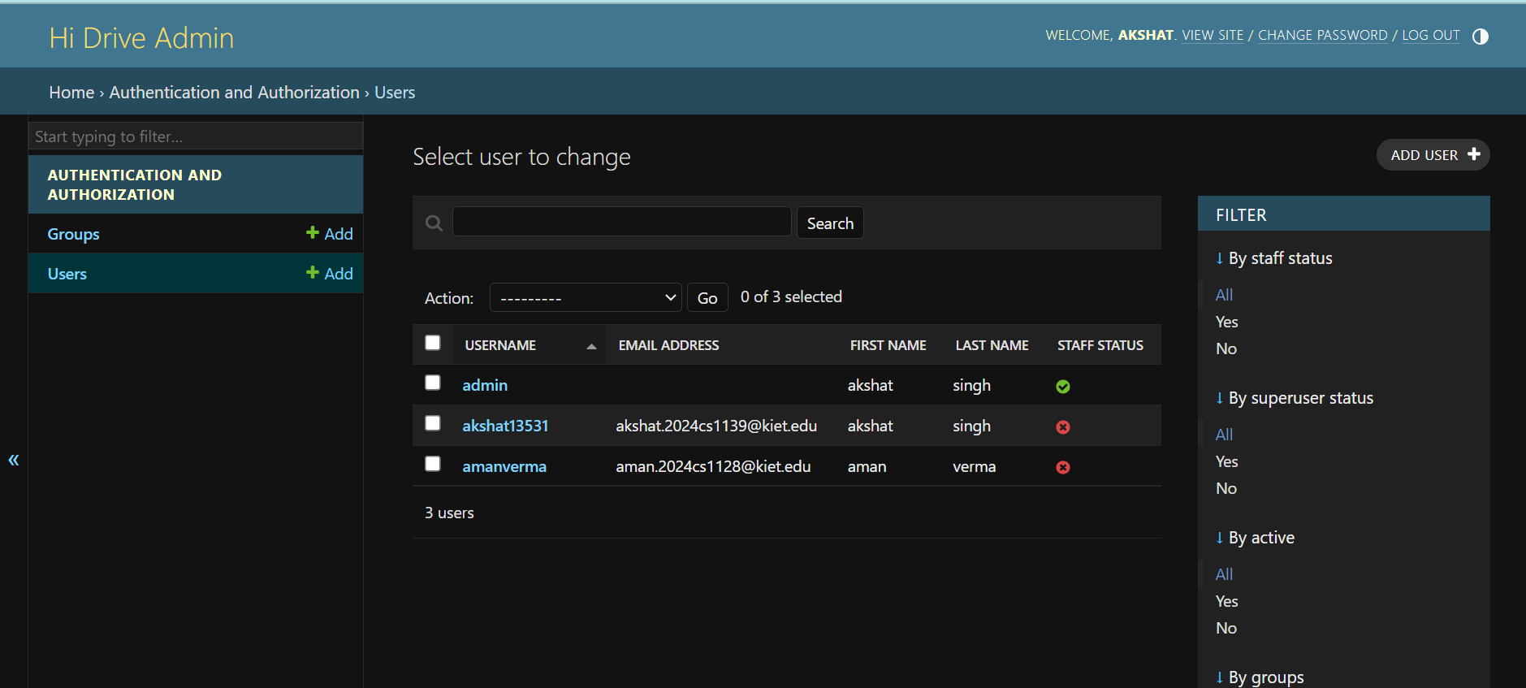
User Administrator Portal Layout

Slide 12
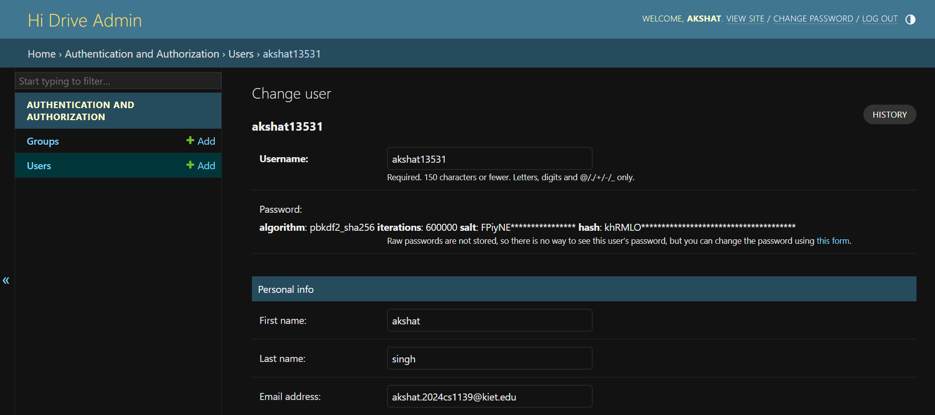

Slide 13
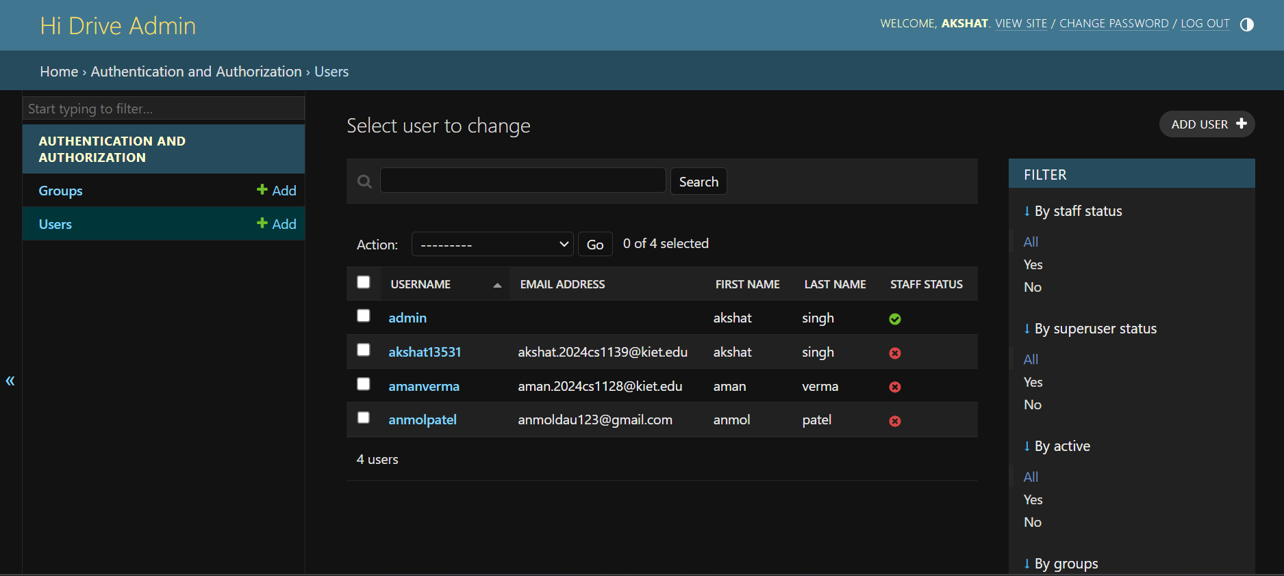

Slide 14
References
[1] V. Hemanth Kumar and K. Sentamilselvan,
“Customer Satisfaction towards Call Taxi Services
A study with reference to Chennai”, International
Journal of Pure and Applied Mathematics, Volume
119 No. 12 2018, 14919-14928.
[2] Dr. Ruchi Shukla, Dr. Ashish Chandra & Ms.
Himanshi Jain, “OLA VS UBER: The Battle of
Dominance”, IOSR Journal of Business and
Management (IOSR-JBM), VINC'17, 73-78.

Slide 15
[3] Dr. P. Kishore Kumar, Dr. N. Ramesh Kumar, “A
Study on Factors Influencing the Consumers in
Selection of Cab Services”, International Journal of
Social Science and Humanities Research ISSN
2348-3164, Vol. 4, Issue 3, Month: July -
September 2016, pp: (557-561).
[4] https//www.olacabs.com/rentals
[5] www.driveu.in/Driver/Pune
[6] www.089drivers.com/

